Slide 1
Content Prepared by
Ms. C. SASIKALA
Assistant Professor,
Department of English,
Jamal Mohamed College,
Trichy – 620 020.

Slide 2
INDIAN WEAVERS
-SAROJINI NAIDU

Slide 3
AGENDA
Introduction
Theme of the poem
Poem lines
Explanation
Literary Devices

Slide 4
Nightingale of India

Slide 5
INTRODUCTION
Sarojini Naidu was an India political leader born on February 13, 1879 in Hyderabad, India. At a young age she wrote poetry and plays, a hobby she kept throughout her life. She later studied in England, and in 1916 she met Mahatma Gandhi which sparked her interest in the fight for India’s freedom. In 1925 she was elected as the first female President of the India National Congress. After India’s independence from England, Naidu became the first woman Governor of Uttar Pradesh. Naidu died on March 02, 1949 at Lucknow, Uttar Pradesh.

Slide 6
THEME OF THE POEM
Indian Weavers by Sarojini Naidu is a short poem consisting of three stanzas having four lines each. The poet talks about three types of dresses that the Indian Weavers weave at three particular times of the day. Metaphorically each time and the dress weaved in that time symbolises a particular stage of life.
The poem has the rhyme scheme AABB

Slide 7
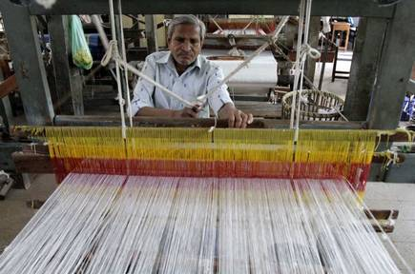
Weavers

Slide 8
POEM LINES
WEAVERS, weaving at break of day,
Why do you weave a garment so gay? . . .
Blue as the wing of a halcyon wild,
We weave the robes of a new-born child.

Slide 9
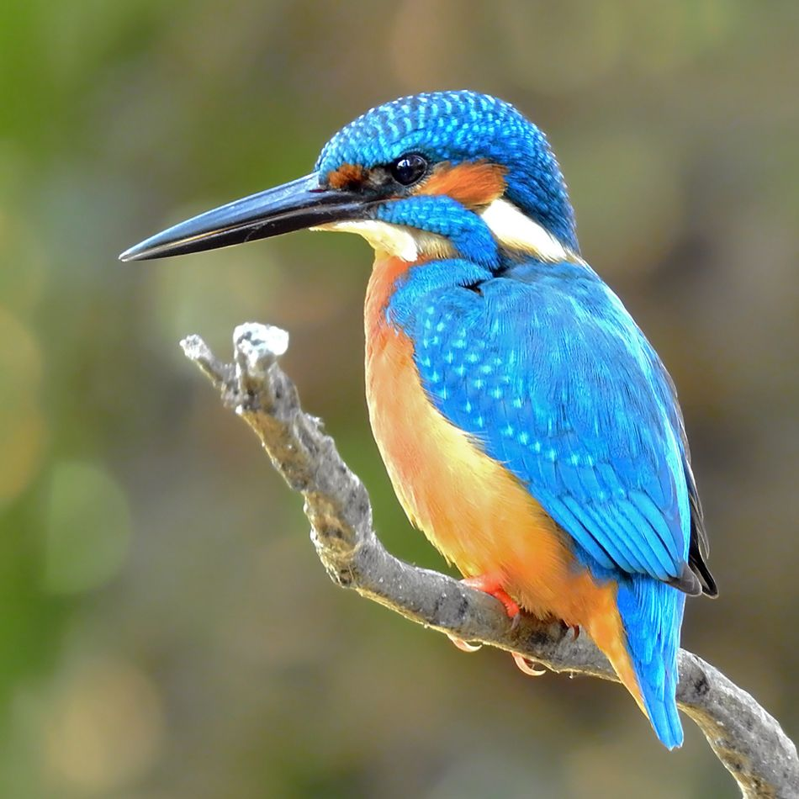
Meanings
A break of day – early morning
Gay – brightly coloured (blue)loyalty,faith
Halcyon – a kingfisher bird.
Garment- clothes

Slide 10
Weavers, weaving at fall of night,
Why do you weave a garment so bright? . . .
Like the plumes of a peacock, purple and green,
We weave the marriage-veils of a queen

Slide 11
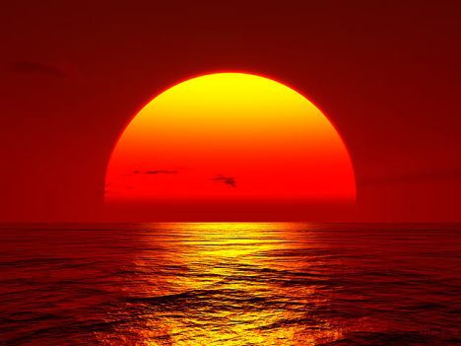
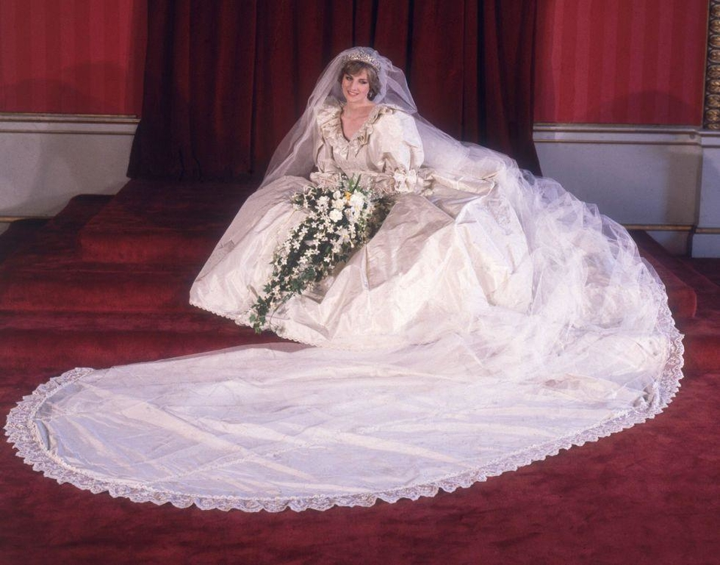
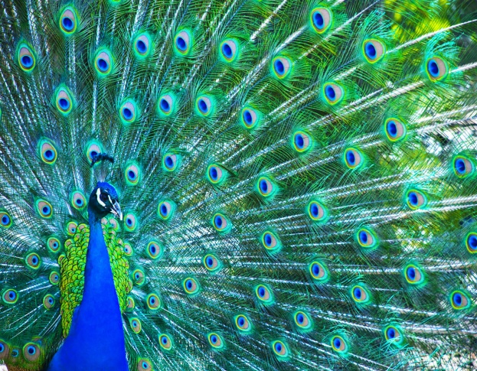
Meaning
Fall of night – at the time of sunset
Plumes-feather
Purple and green- here it refers to
peacock
Marriage-veils –a piece of material
Cover the face or head

Slide 12
Weavers, weaving solemn and still,
What do you weave in the moonlight chill? . . .
White as a feather and white as a cloud,
We weave a dead man's funeral shroud

Slide 13
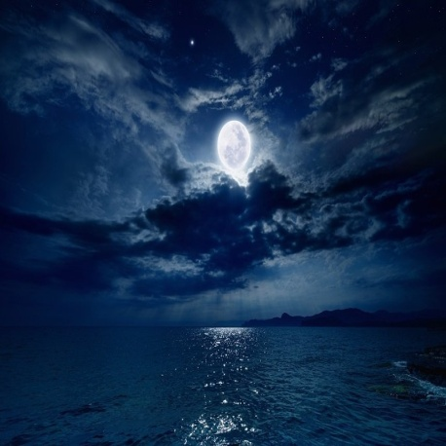
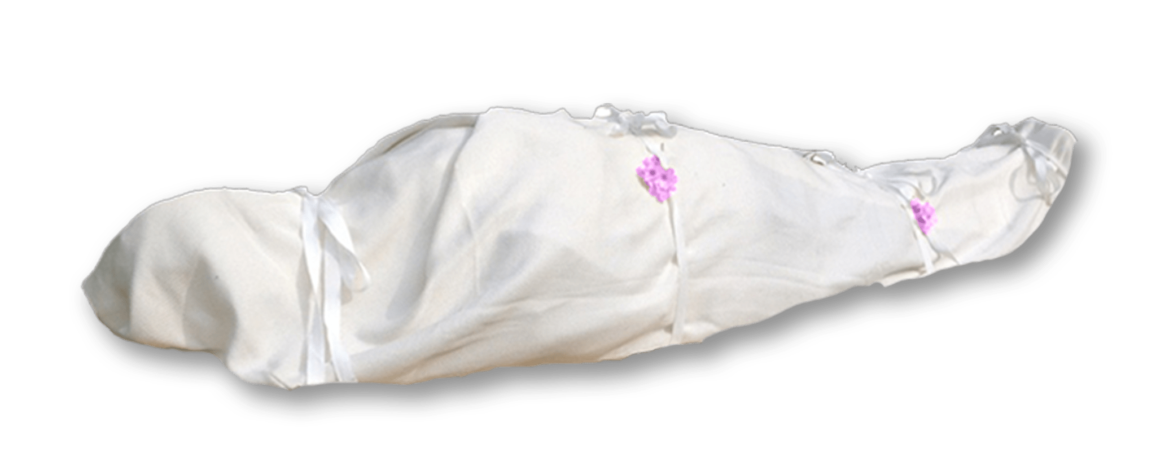
Meanings
Moonlight chill-the cooling came from
the moon
Funeral shroud- a cloth used to
wrap a dead body before it is buried.

